Slide 1
Fishing and Netting on the Chesapeake Bay
Netting on the Chesapeake Bay
An investigation by: Alana Davitt
An investigation by Alana Joy Davitt
for The Chesapeake Bay Fellows Program

Slide 2
Stationary Uncovered Pound Netting “Pound net means a stationary or fixed fishing device consisting of several stakes or poles which have been pushed or pumped into the bottom and attached to netting which forms a straight wall or leader which serves to guide fish through a funnel and heart shaped enclosure into a terminal head or pocket with a netting floor”

Slide 3
How it works

Slide 4
Nearing the nets

Slide 5
Into the nets

Slide 6
Holding pool for caught fish

Slide 7
Escaping the pole nets

Slide 8
Gill Netting

Slide 9
How it works

Slide 10
Number of fish caught according to population number (in thousands) using gill nets

Slide 11
Pulling in the nets

Slide 12
Checking for fish

Slide 13
Cast Netting “Cast nets are limp circles of mesh netting surrounded on their outer edge by lead weights. The user is supposed to throw the netting over a school of fish, allow the net to sink then pull the connected pull handlines to close the net around the catch. While this may sound simple, it takes many users years to master the art. ”

Slide 14
How it works

Slide 15
Seine Netting

Slide 16
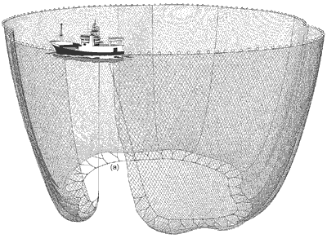
How it works
‘simple’ seine net
‘purse’ seine net

Slide 17
The community’s view

Slide 18
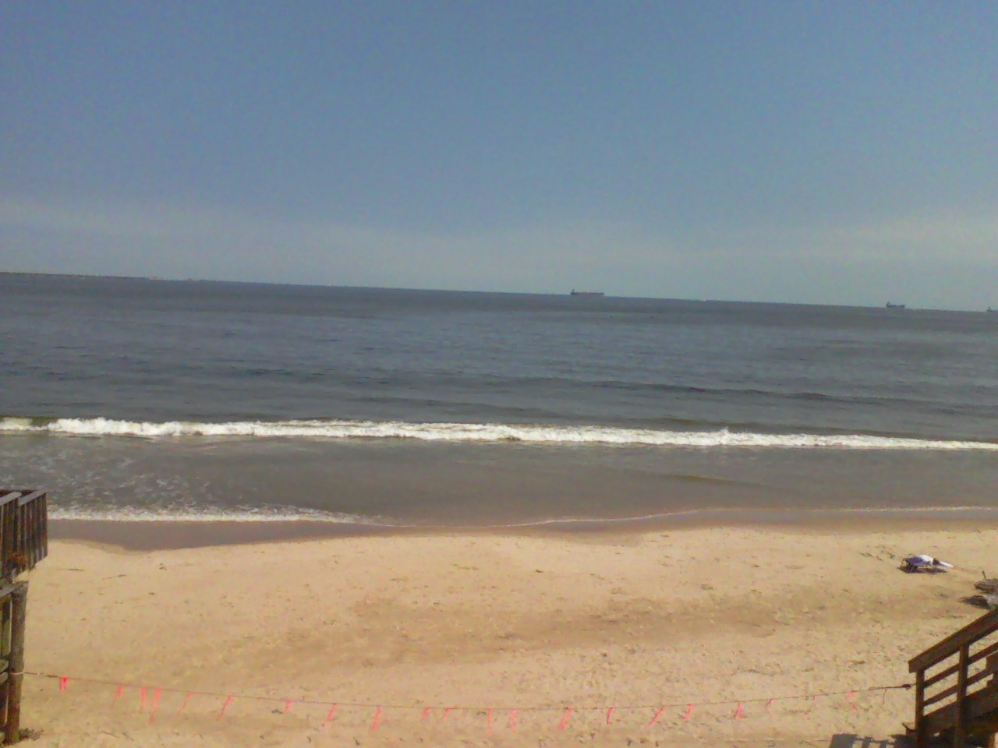
Some Sources
Some Sources:
Food and Agriculture Organization of the United Nations: Fisheries and Aquaculture Department
Virginia Marine Resources Commission
http://www.stripers247.com/illegalgillnetting.htm
http://www.castingnet.cn/history.asp
Food and Agriculture Organization of the United Nations: Fisheries and Aquaculture Department
Virginia Marine Resources Commission

